Slide 1
PHISHING CAMPAIGN
SIMULATION
Security Awareness Project
Project Team: Kutu & Mr Ben
Neocloud Technologies • Instructor: Mr Victor

Slide 2
1. What Is This Project?
We are teaching people how to recognize phishing emails.
Phishing is when someone uses a fake message to trick a person.
We created a SAFE practice version inside a controlled lab.
The goal is to learn how to spot the warning signs.
Kutu & Mr Ben • Phishing Campaign Simulation • 2

Slide 3
2. What Did We Want to Achieve?
Create a fake phishing message for training.
Send it only to approved test accounts.
See what happens when a user opens or clicks the message.
Use the results to teach better security habits.
Kutu & Mr Ben • Phishing Campaign Simulation • 3

Slide 4
3. Tools We Used
Kali Linux — our security testing computer.
GoPhish — used to create and manage the simulation.
Mailtrap — used for safe email testing.
HTML / Canva — used to create the training content.
Kutu & Mr Ben • Phishing Campaign Simulation • 4

Slide 5

4. How The Project Works
1
Create
Email
2
Send
Safely
3
User
Clicks
4
Show
Warning
5
Teach
User
Kutu & Mr Ben • Phishing Campaign Simulation • 5

Slide 6
5. What We Have Completed
Kali Linux lab is ready.
GoPhish was installed and the dashboard works.
The Mailtrap testing setup was added.
The project team can create the campaign from the GoPhish dashboard.
Kutu & Mr Ben • Phishing Campaign Simulation • 6

Slide 7
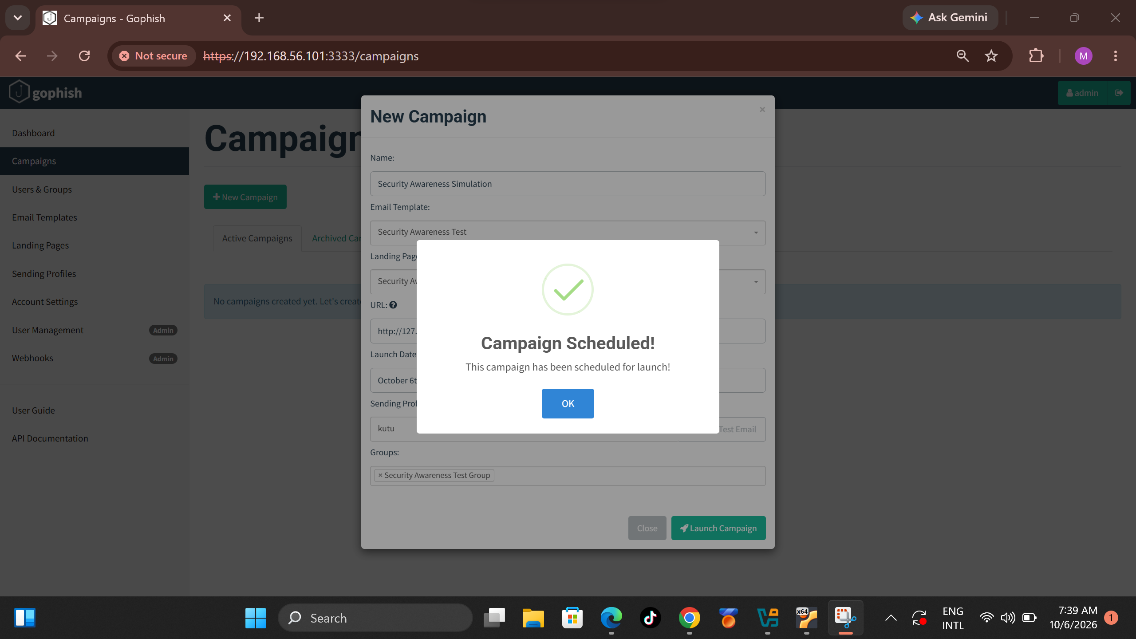
6. The Email Test
SMTP Test — Successfully Completed
The GoPhish SMTP connection was successfully configured with Mailtrap.
A test email was sent successfully and received in the Mailtrap inbox.
This confirmed that the SMTP configuration was working correctly.
Kutu & Mr Ben • Phishing Campaign Simulation • 7

Slide 8
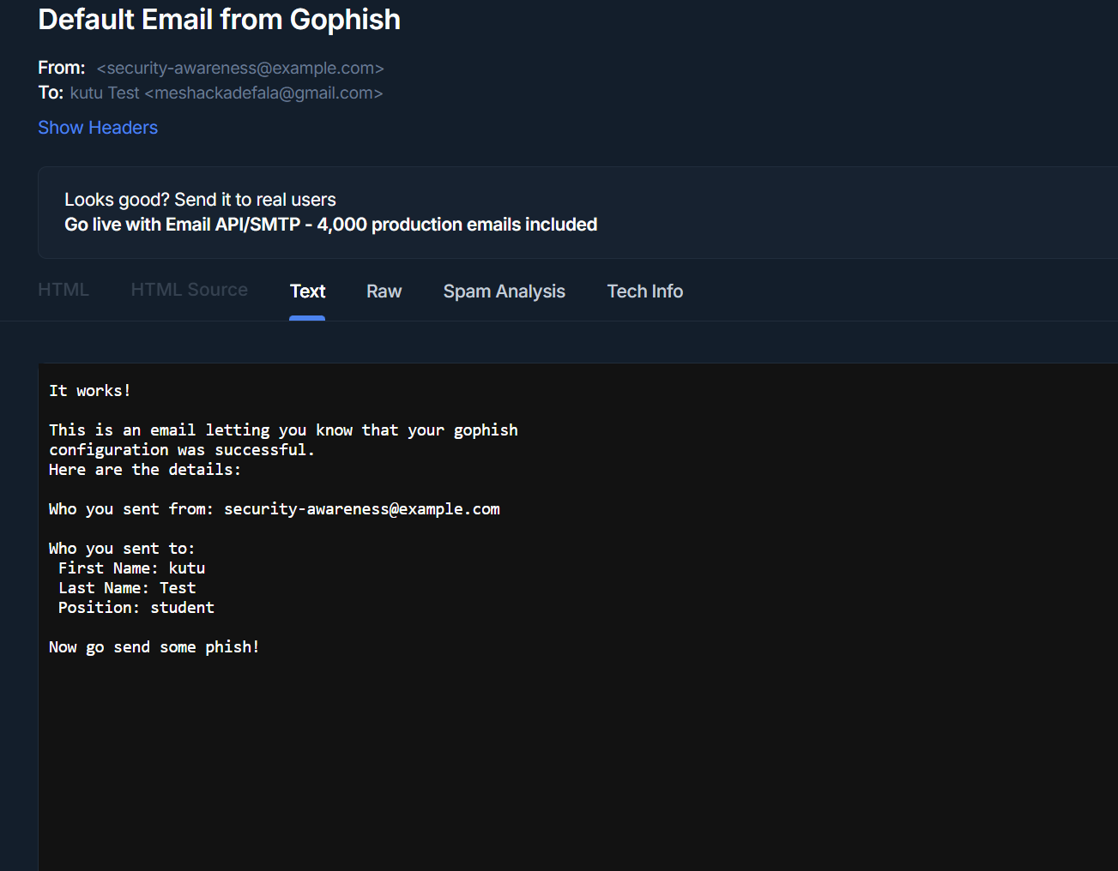
7. What Happens When It Works?
A test email is sent to an approved test account.
The user opens the message.
The user may click the training link.
The training page explains the warning signs.
GoPhish records the activity for the project report.
Kutu & Mr Ben • Phishing Campaign Simulation • 8

Slide 9
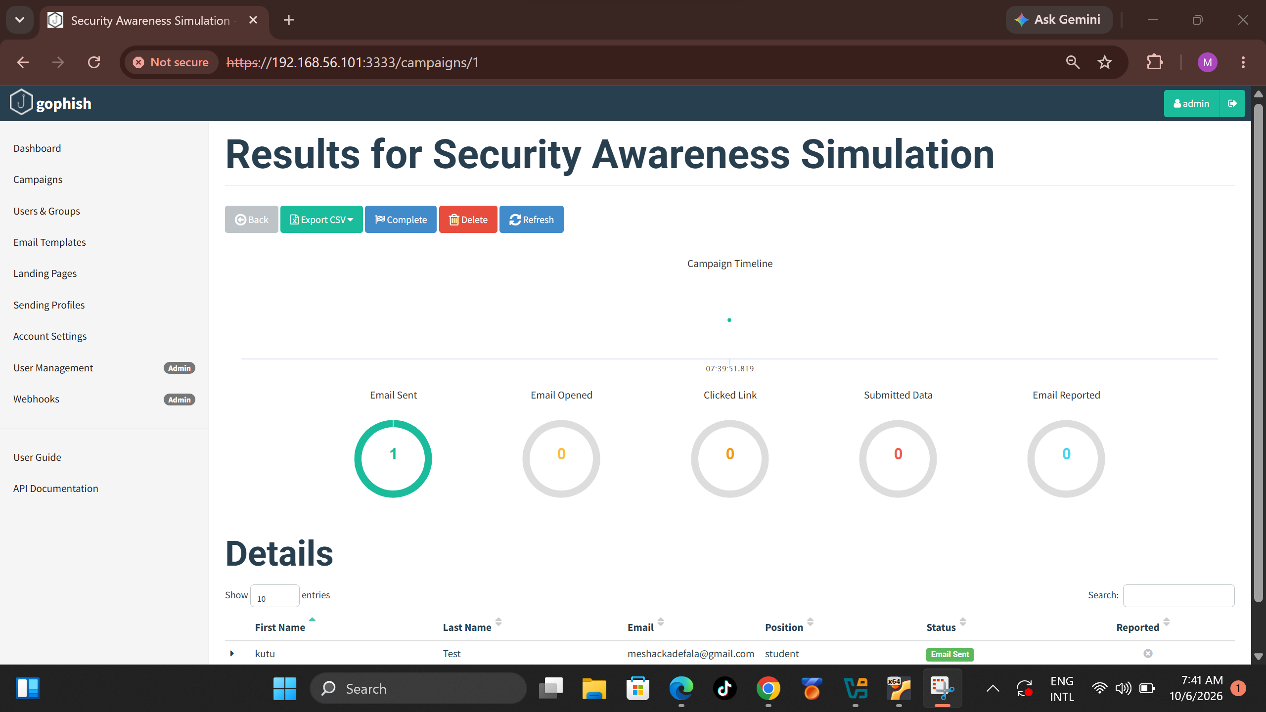
8. What Will We Measure?
Delivered — did the email arrive?
Opened — did the user open it?
Clicked — did the user click the link?
Reported — did the user recognize and report it?
These results show where more training is needed.
Kutu & Mr Ben • Phishing Campaign Simulation • 9

Slide 10
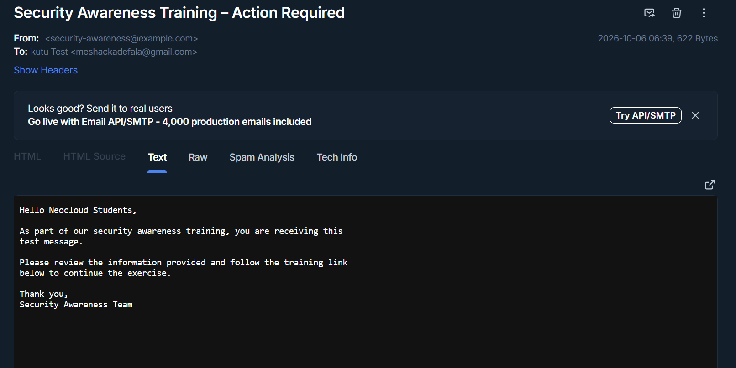
9. What Should People Learn?
Check the sender before trusting an email.
Do not rush because a message says “URGENT.”
Check links before clicking.
Never give your password to an unexpected email.
When unsure, report the message.
Kutu & Mr Ben • Phishing Campaign Simulation • 10

Slide 11
10. Safety & Ethics
This is an educational project.
Only authorized test accounts should be used.
No real passwords or sensitive information should be collected.
The purpose is awareness — not harming or accessing real accounts.
Kutu & Mr Ben • Phishing Campaign Simulation • 11

Slide 12
11. Final Result
The controlled phishing-awareness campaign was successfully launched.
The simulated email was delivered and appeared in Mailtrap.
The test activity was recorded by GoPhish.
The successful delivery confirmed that the complete workflow was operational..
Kutu & Mr Ben • Phishing Campaign Simulation • 12

Slide 13
12. Conclusion
  The phishing campaign simulation was successfully completed in a controlled laboratory environment.
  GoPhish and Mailtrap were configured successfully, the awareness email was delivered, and the training workflow was demonstrated.
  The practical exercise showed how phishing simulations can be used to improve user awareness and identify risky email behavior.
  All testing was performed using an authorized test recipient without collecting real credentials or sensitive information.

Slide 14
13. References
  NIST — Cybersecurity and phishing-awareness guidance: https://www.nist.gov/
  GoPhish — Phishing simulation and security awareness platform: https://getgophish.com/
  Kali Linux — Security testing platform: https://www.kali.org/
  Mailtrap — Email testing platform: https://mailtrap.io/
  Project materials and observations from the controlled lab environment.

